Slide 1
第二次习题课
生物信息学导论
教师：Shao Li
助教：Songpeng Zu
2014-10-21

Slide 2
CONTENT
The NCBI Website
BLAST from NCBI
p-value and Multiple Hypotheses Testing
Motif Finding
*Regular Expression
Reference

Slide 3
The NCBI Website
National Center for Biotechnology Information (NCBI), http://www.ncbi.nlm.nih.gov/ is part of United States National Library of Medicine (NLM), a branch of the National Institutes of Health (NIH).
Including:
PubMed
BLAST and other tools
DNA, RNA and Proteins
Genome Data
OMIM
PubChem
…
Similar Website: EMBL-EBI (The European Bioinformatics Institute).
http://www.ebi.ac.uk/

Slide 4

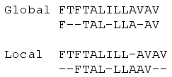
BLAST
Sequence Alignment
BLAST
E-value

Slide 5
Methods of Sequence Alignment
Pair-wise Sequence Alignment
Dot Matrix Analysis
Dynamic Programming Algorithm
Word or k-tuple methods (BLAST,FASTA,BLAT)
Multiple Sequence Alignment

Slide 6
Dynamic Programming
A general algorithm design technique for solving problems defined by recurrences with overlapping sub problems.
Global alignment : Needleman-Wunsch
Local alignment : Smith-Waterman
Both of them used dynamic programming.

Slide 7
Global Alignment

Slide 8
Theorem. C(i,j) satisfies the following relationships:
Initial conditions:
Recurrence relation: For 1 ≤ i ≤ n, 1 ≤ j ≤ m:

Slide 9
Justification
S₁ S₂ . . . S_{i-1} S_{i}
S₁ S₂ . . . S_{i-1} S_{i}
T₁ T₂ . . . T_{j-1} T_{j}
T₁ T₂ . . . T_{j} —
C(i-1,j-1) + w(S_{i},T_{j})
C(i-1,j) −γ
S₁ S₂ . . . S_{i} —
T₁ T₂ . . . T_{j-1} T_{j}
C(i,j-1) −γ

Slide 10
Example
Case 1: Line up S_{i} with T_{j}
i
i - 1
S: C A T T C A C
T: C - T T C A G
j -1
j
Case 2: Line up S_{i} with space
i - 1
i
S: C A T T C A - C
T: C - T T C A G -
j
Case 3: Line up T_{j} with space
i
S: C A T T C A C -
T: C - T T C A - G
j -1
j

Slide 11
Computation Procedure
C(0,0)
C(i-1,j-1)
C(i-1,j)
C(i,j-1)
C(i,j)
C(n,m)

Slide 12
λ C T C G C A G C
λ
0 -5 -10 -15 -20 -25 -30 -35 -40
C
-5
10
5
A
-10
T
-15
T
-20
C
-25
A
-30
C
-35
+10 for match, -2 for mismatch, -5 for space
Notes:
We first compute T[i, j] for the smallest possible values of i and j, then for increasing values of i and j
Usually performed with a table of size
(n + 1) X (m + 1)

Slide 13
λ C T C G C A G C
λ
0 | -5 | -10 | -15 | -20 | -25 | -30 | -35 | -40
-5 | 10 | 5 | 0 | -5 | -10 | -15 | -20 | -25
-10 | 5 | 8 | 3 | -2 | -7 | 0 | -5 | -10
-15 | 0 | 15 | 10 | 5 | 0 | -5 | -2 | -7
-20 | -5 | 10 | 13 | 8 | 3 | -2 | -7 | -4
-25 | -10 | 5 | 20 | 15 | 18 | 13 | 8 | 3
-30 | -15 | 0 | 15 | 18 | 13 | 28 | 23 | 18
-35 | -20 | -5 | 10 | 13 | 28 | 23 | 26 | 33
C
A
T
*
T
*
C
A
C
Traceback can yield both optimum alignments

Slide 14
Local alignment
Initialize with zeros (free gaps at start).
Locate max position.

Slide 15
λ C T C G C A G C
λ
0 0 0 0 0 0 0 0 0
C
0
10 5 10 5 10 5 0 10
A
0
5 8 5 8 5 20 15 10
T
0
0 15 10 5 6 15 18 13
T
0
-2 10 13 8 3 10 13 16
C
0
10 5 20 15 18 13 8 23
A
0
5 8 15 18 13 28 23 18
G
0
0 3 10 25 20 23 38 33
+10 for match, -2 for mismatch, -5 for gap
Notes:
We first compute T[i, j] for the smallest possible values of i and j, then for increasing values of i and j
Usually performed with a table of size
(n + 1) X (m + 1)

Slide 16
E-value
Assesse the statistical significance of a particular alignment.
E-value: The expected (average) number of alignments with scores bigger than or equal to “S” that are expected to occur by chance.
How to evaluate the E-value?

Slide 17
How to evaluate the E-value?
The random sequence alignment scores follow a distribution called the extreme value distribution.
The number of matched regions that exceeds the alignment score could be predicted by the Poisson distribution where the mean of the Poisson distribution is given by the alignment score.

Slide 18
0.40
0.35
0.30
0.25
normal
distribution
probability
0.20
0.15
0.10
0.05
0
-5
-4
-3
-2
-1
0
1
2
3
4
5
x

Slide 19
The probability density function of the extreme
value distribution (characteristic value u=0 and
decay constant λ=1)
0.40
0.35
0.30
0.25
normal
distribution
extreme
value
distribution
probability
0.20
0.15
0.10
0.05
0
-5
-4
-3
-2
-1
0
1
2
3
4
5
x

Slide 20
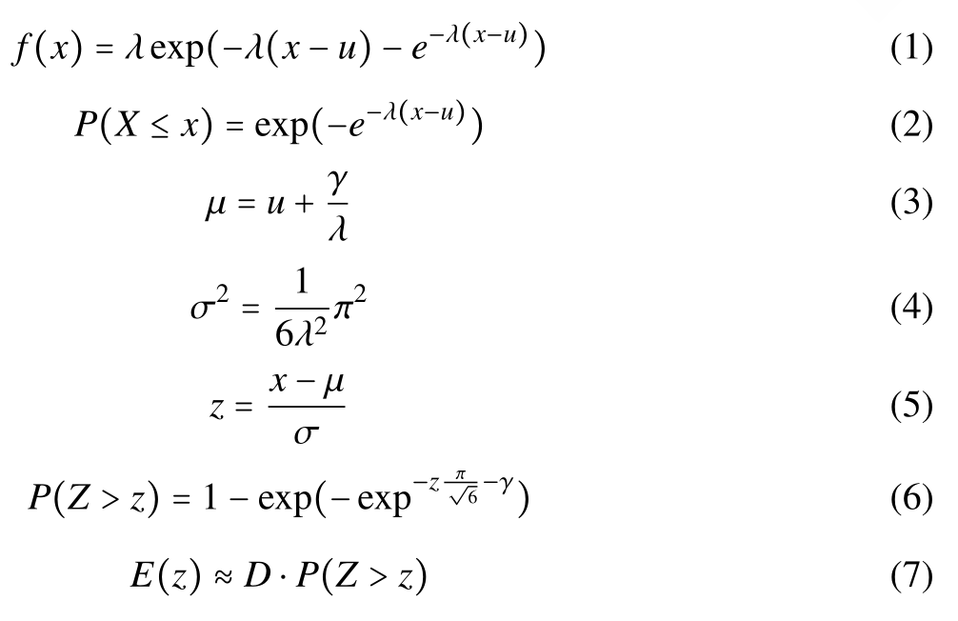
How to evaluate the E-value?
Euler-Mascheroni costant

Slide 21
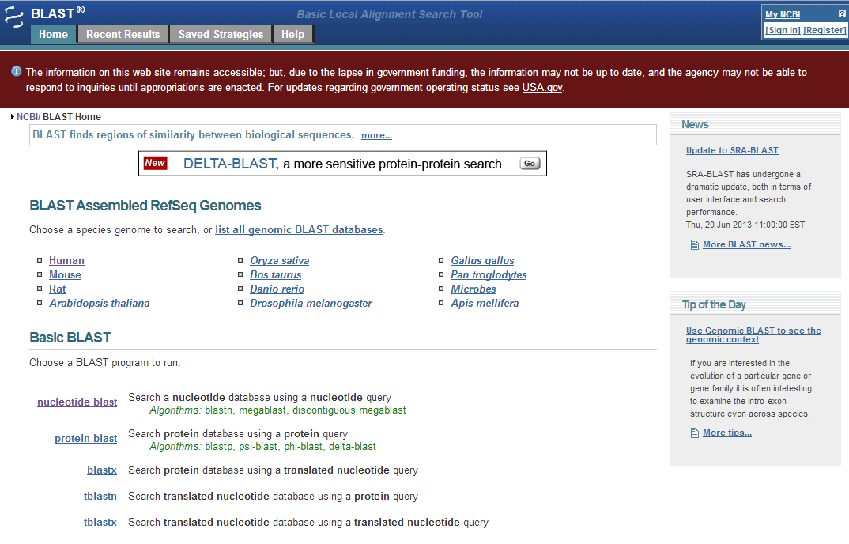
BLAST
Basic Local Alignment Search Tool or BLAST allows rapid sequence comparison of a sequence against a database.

Slide 22
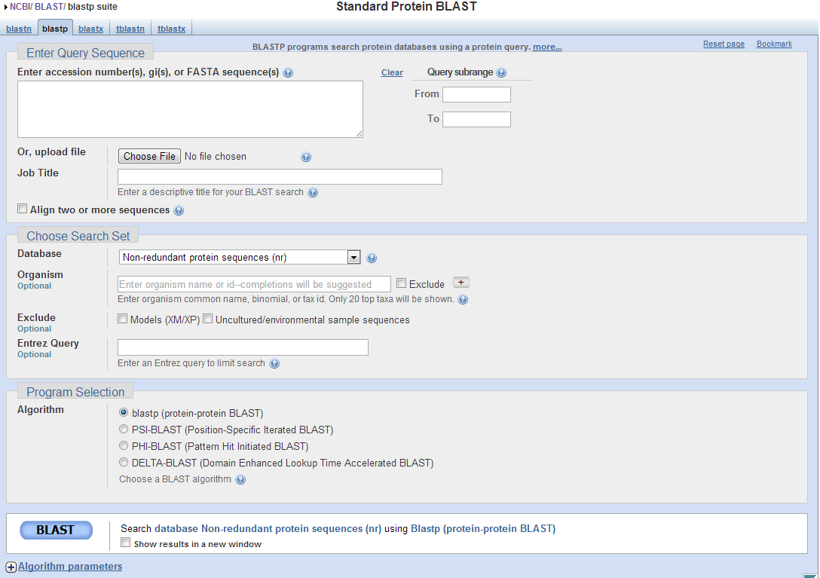

Slide 23
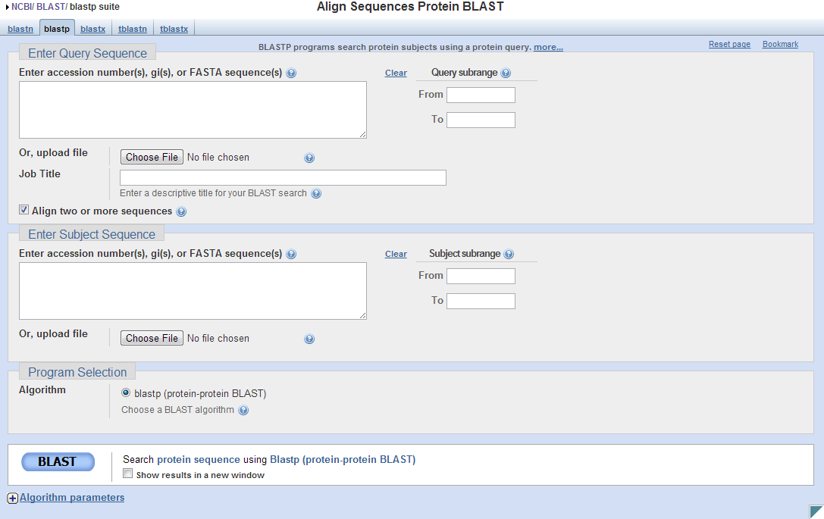

Slide 24
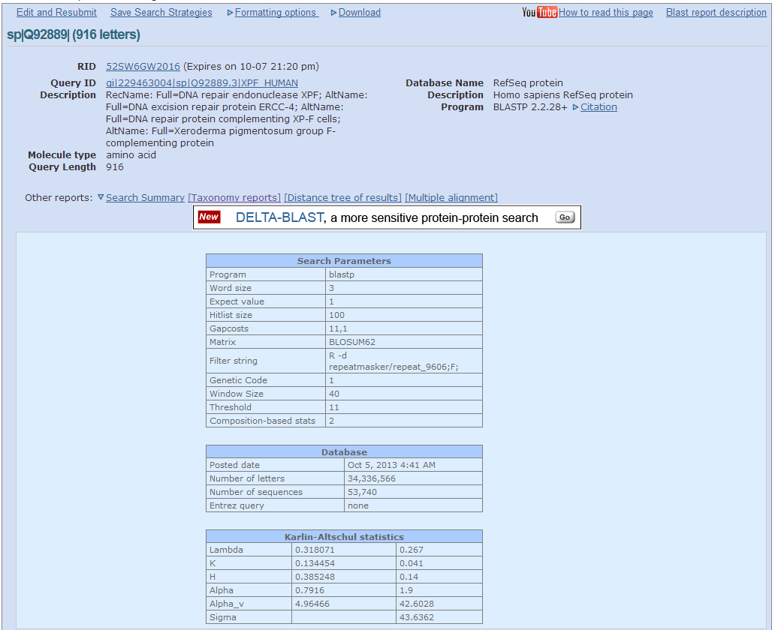

Slide 25
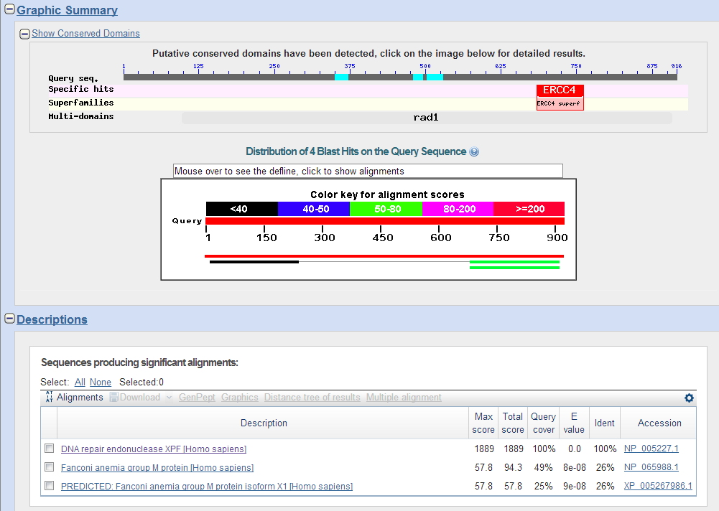

Slide 26
How a BLAST search works
“The central idea of the BLAST
algorithm is to confine attention
to segment pairs that contain a
word pair of length w with a score
of at least T.”
Altschul et al. (1990)

Slide 27
How the original BLAST algorithm works:
3 phases
Phase 1: compile a list of word pairs (w = 3)
above threshold T
Example: for a human RBP query
…FSGTWYA…
A list of words (w = 3) is:
FSG SGT GTW TWY WYA
YSG TGT ATW SWY WFA
FTG SVT GSW TWF WYS

Slide 28
Phase 1: compile a list of words (w=3)
GTW 6,5,11 22
neighborhood GSW 6,1,11 18
word hits ATW 0,5,11 16
> threshold DTW -1,5,11 15
GTY 6,5, 2 13
GNW 10
GAW 9
word hits
below threshold
(T=11)

Slide 29
How a BLAST search works: 3 phases
Phase 2:
Scan the database for entries that match the
compiled list.
This is fast and relatively easy.

Slide 30
How a BLAST search works: 3 phases
Phase 3: when you manage to find a hit
(i.e. a match between a “word” and a database
entry), extend the hit in either direction.
Keep track of the score (use a scoring matrix)
Stop when the score drops below some cutoff.
KENFDKARFSGTWYAMAKKDPEG 50 RBP (query)
MKGLDIQKVAGTWYSLAMAASD. 44 lactoglobulin (hit)
extend
extend
Hit!

Slide 31
How a BLAST search works: 3 phases
Phase 3:
In the original (1990) implementation of BLAST,
hits were extended in either direction.
In a 1997 refinement of BLAST, two independent
hits are required. The hits must occur in close
proximity to each other (40 nt). With this modification, only one seventh as many extensions occur, greatly speeding the time required for a search.

Slide 32
How a BLAST search works: threshold
You can modify the threshold parameter.
The default value for blastp is 11.
To change it, enter “-f 16” or “-f 5” in the
advanced options.

Slide 33
How to interpret a BLAST search: expect value
The expect value E is the number of alignments
with scores greater than or equal to score S
that are expected to occur by chance in a
database search.
An E value is related to a probability value p.
The key equation describing an E value is:
E = Kmn e^{-λS}

Slide 34
E = Kmn e^{-λS}
This equation is derived from a description
of the extreme value distribution
S = the score
E = the expect value = the average number of HSPs (High Score Pairs) expected to occur with
a score of at least S
m, n = the length of two sequences
λ, K = Karlin-Altschul statistics

Slide 35
How to interpret BLAST: E values and p values
The expected value E is the number of alignments
with scores greater than or equal to score S
that are expected to occur by chance in a
database search. A p value is a different way of
representing the significance of an alignment.
p = 1 - e^{-Ε}
“p value” is the probability that a random alignment occurring with a score bigger than or equal to “S”.

Slide 36
How to interpret BLAST: E values and p values
Very small E values are very similar to p values.
E values of about 1 to 10 are far easier to interpret
than corresponding p values.
E p
10 0.99995460
5 0.99326205
2 0.86466472
1 0.63212056
0.1 0.09516258 (about 0.1)
0.05 0.04877058 (about 0.05)
0.001 0.00099950 (about 0.001)
0.0001 0.0001000

Slide 37
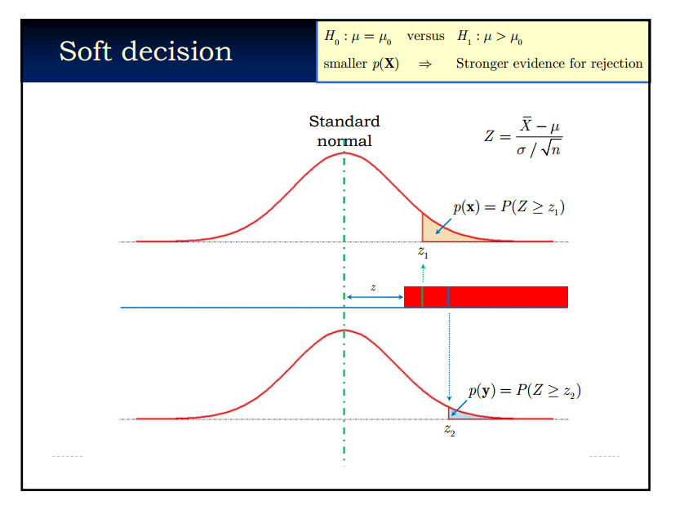
p-value

Slide 38
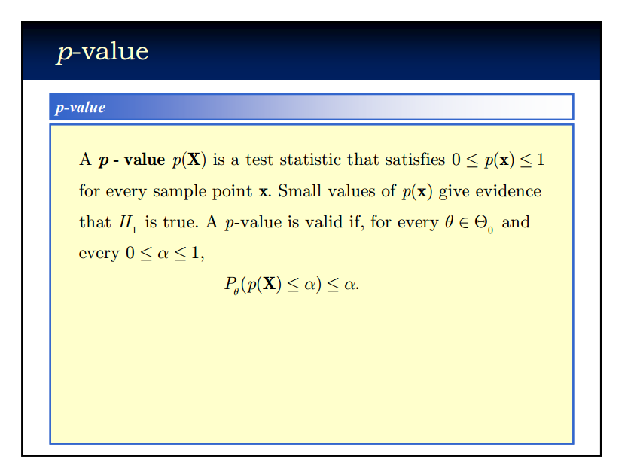

Slide 39
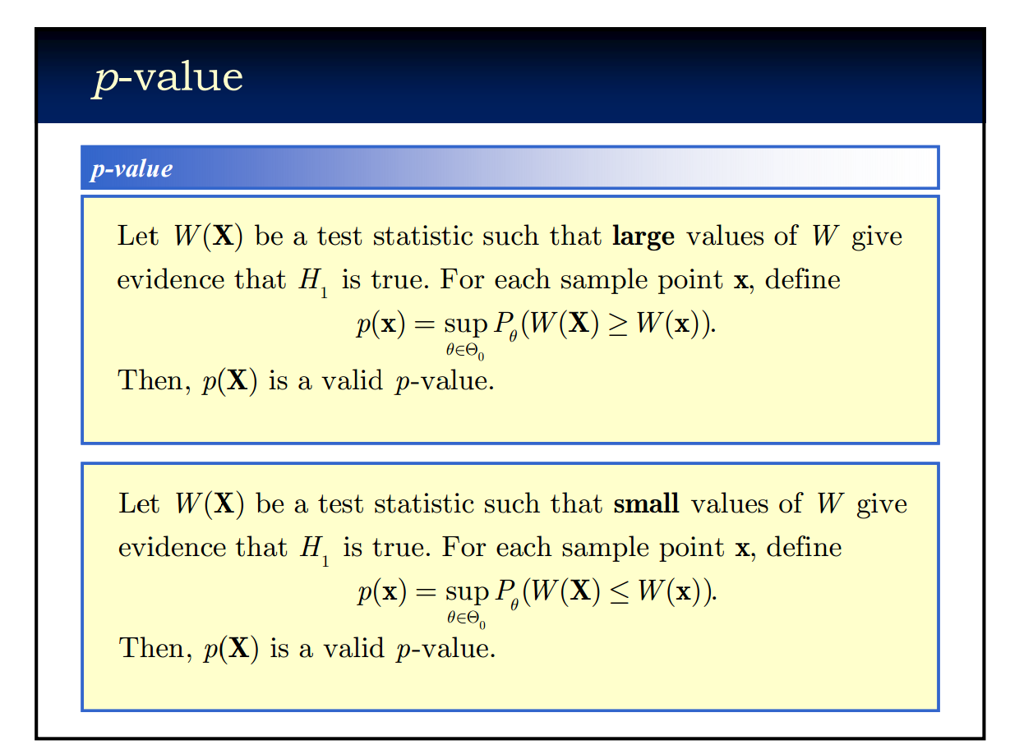

Slide 40
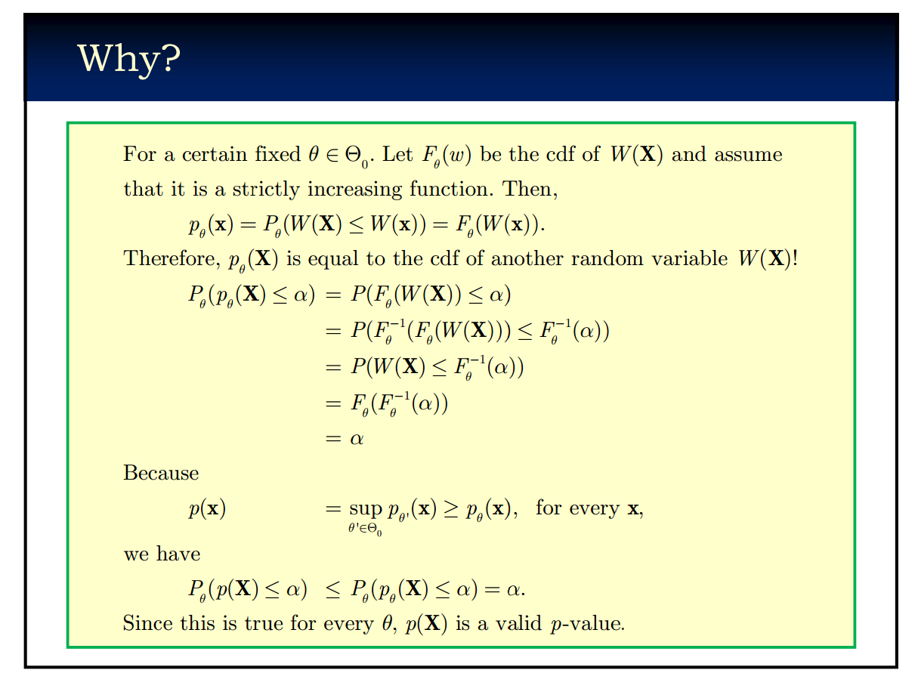

Slide 41
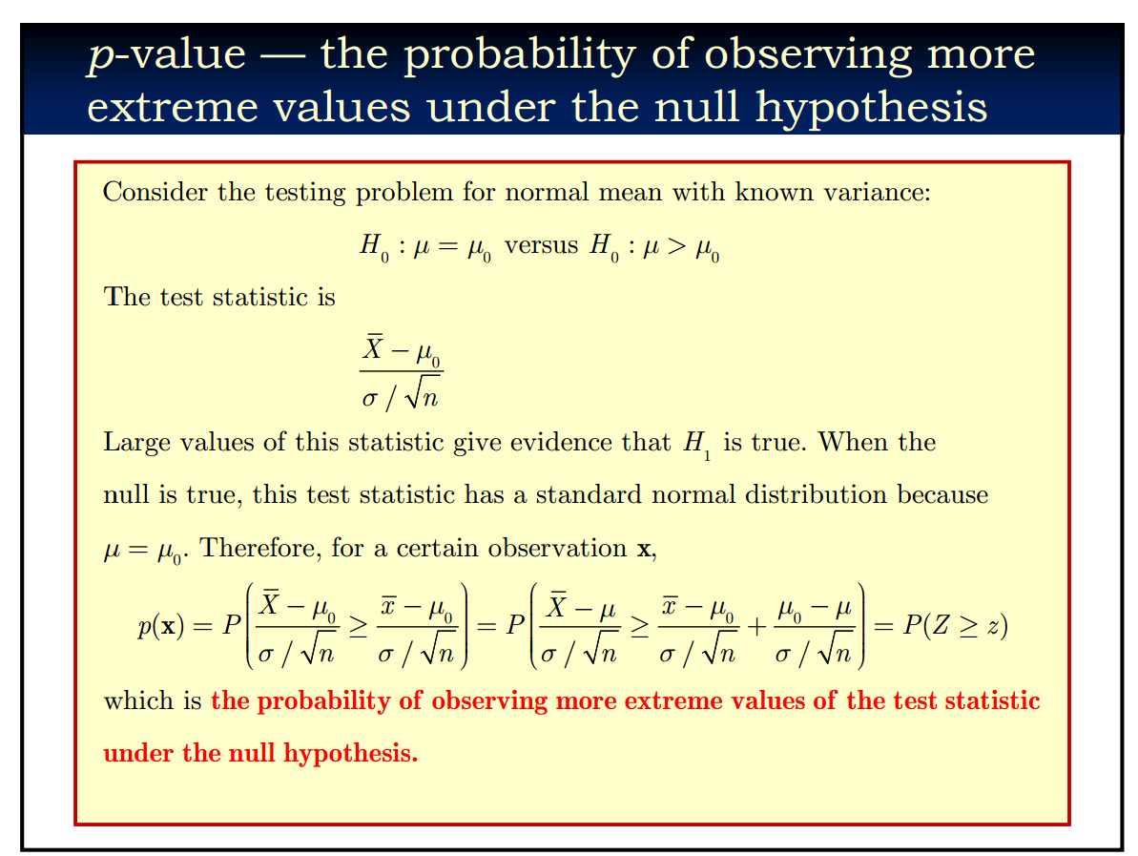

Slide 42
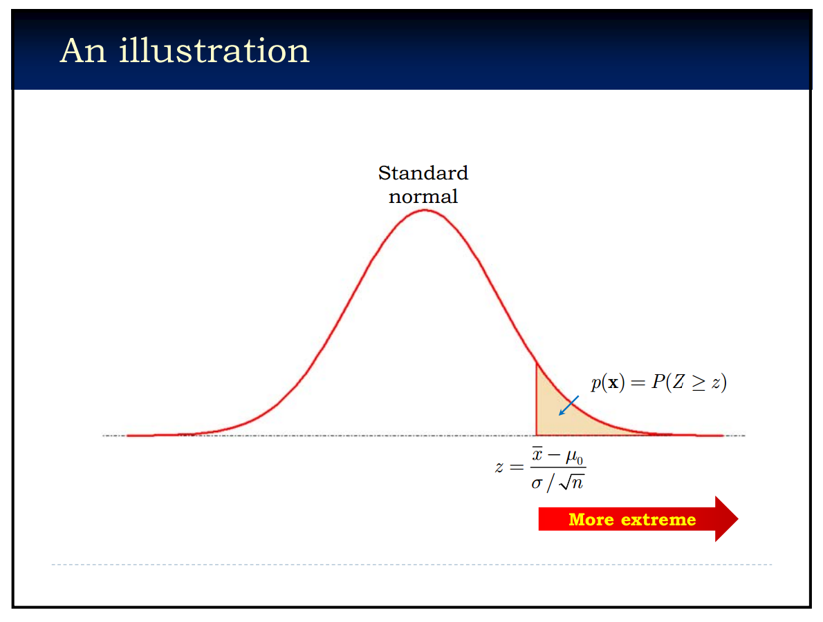

Slide 43
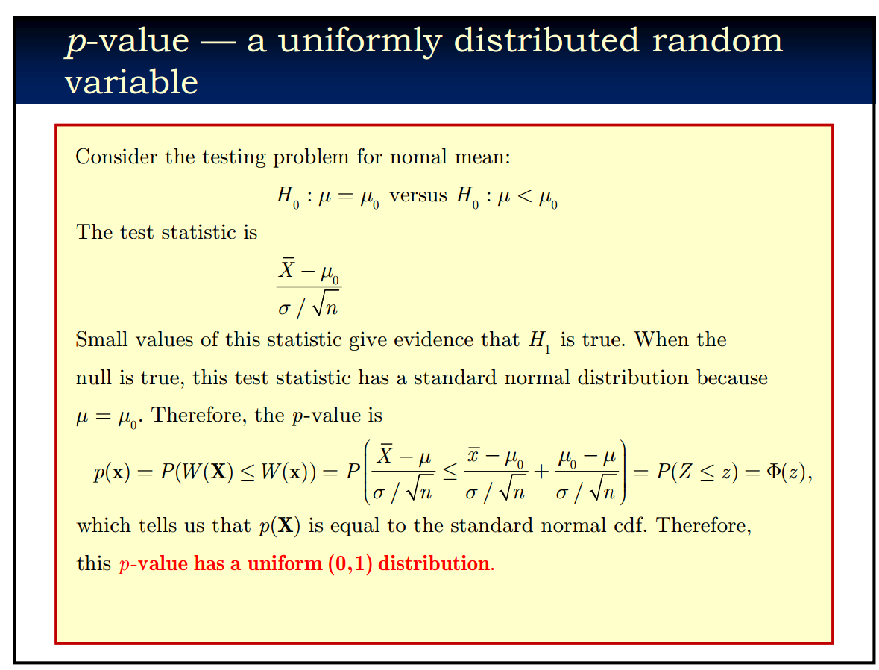

Slide 44
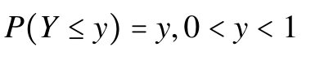
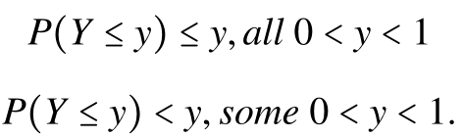
Note
Let X have continuous cdf Fx(X) and define Y = Fx(X). Then Y is uniformly distribution on (0,1).
For discrete random variables, we have:

Slide 45
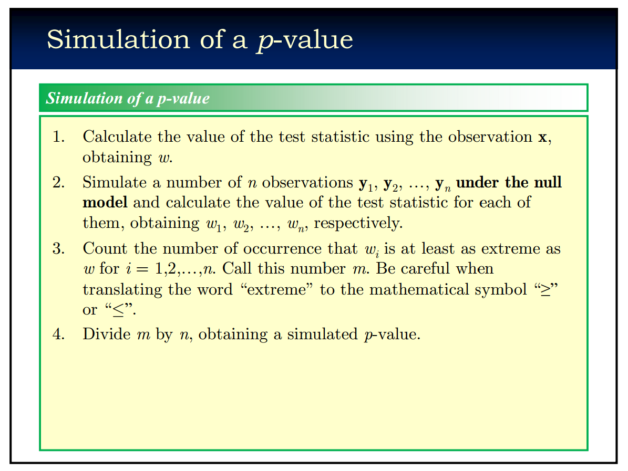

Slide 46
p-value
A test statistic.
The probability of observing more extreme value of the realized test statistic under the null hypothesis.
Usually uniformly distributed under the null hypothesis.
Simulation of a p-value is important.

Slide 47
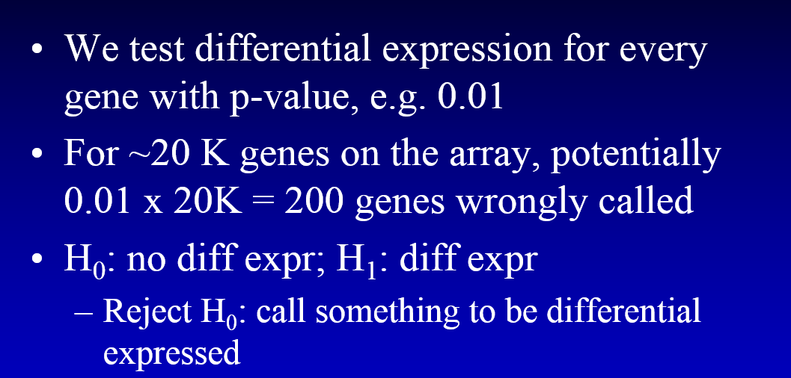
Multiple Hypotheses Testing
What will happen when you simultaneously do multiple hypotheses testing?
Should control family-wise error rate or false discovery rate.

Slide 48
Family-Wise Error Rate (FWER)
P(false rejection at most one hypothesis) < α
Bonferroni correction: to control the family-wise error rate for testing m hypotheses at level α, we need to control the false rejection rate for each individual test at α/m.
If α is 0.05, for 20K gene prediction, p-value cutoff is 0.05/20K.
conservative.

Slide 49
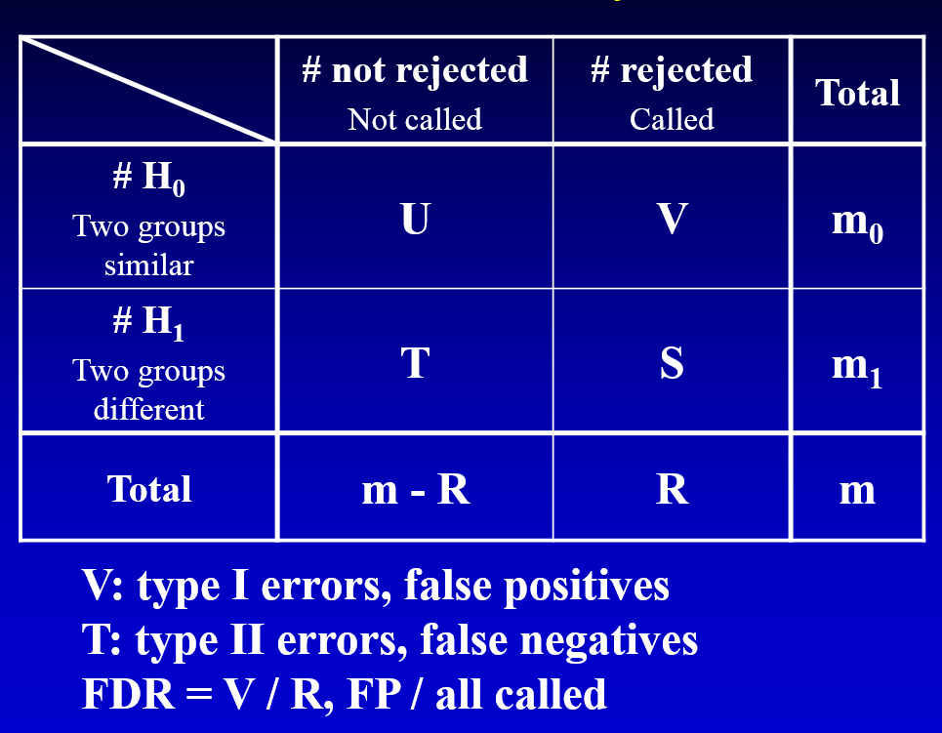
False Discovery Rate
In fact, FDR= E(V/R)

Slide 50
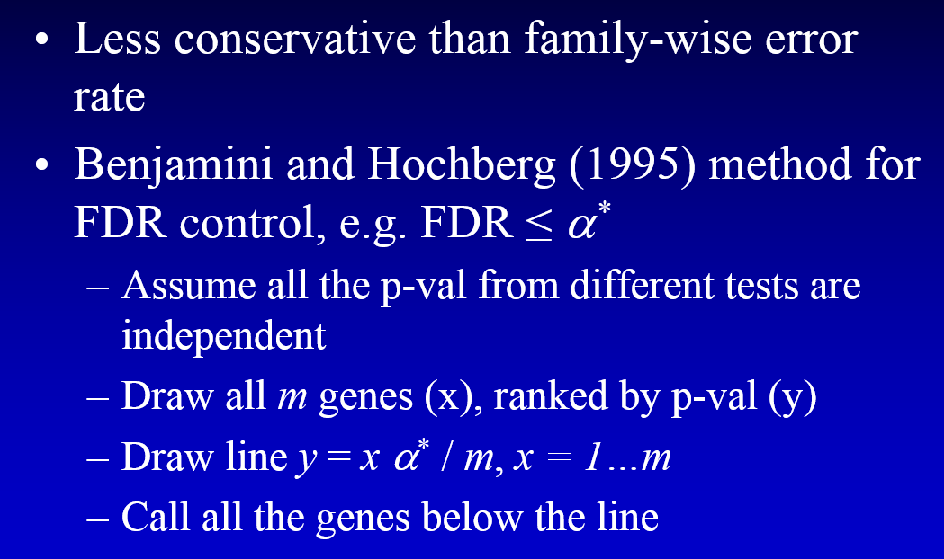
False Discovery Rate

Slide 51
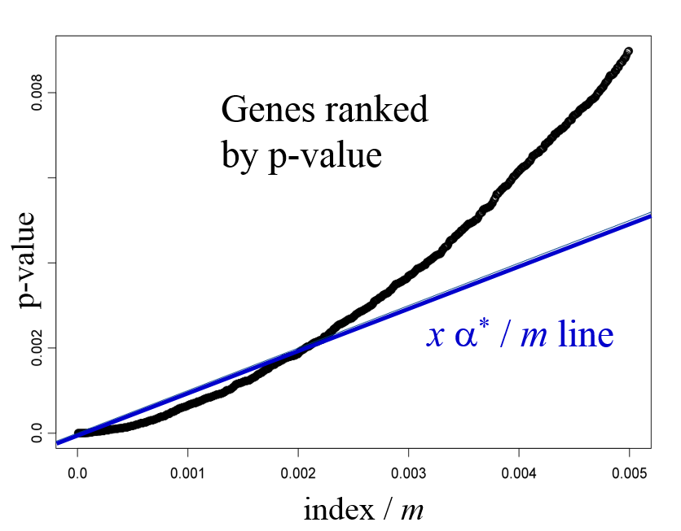

Slide 52
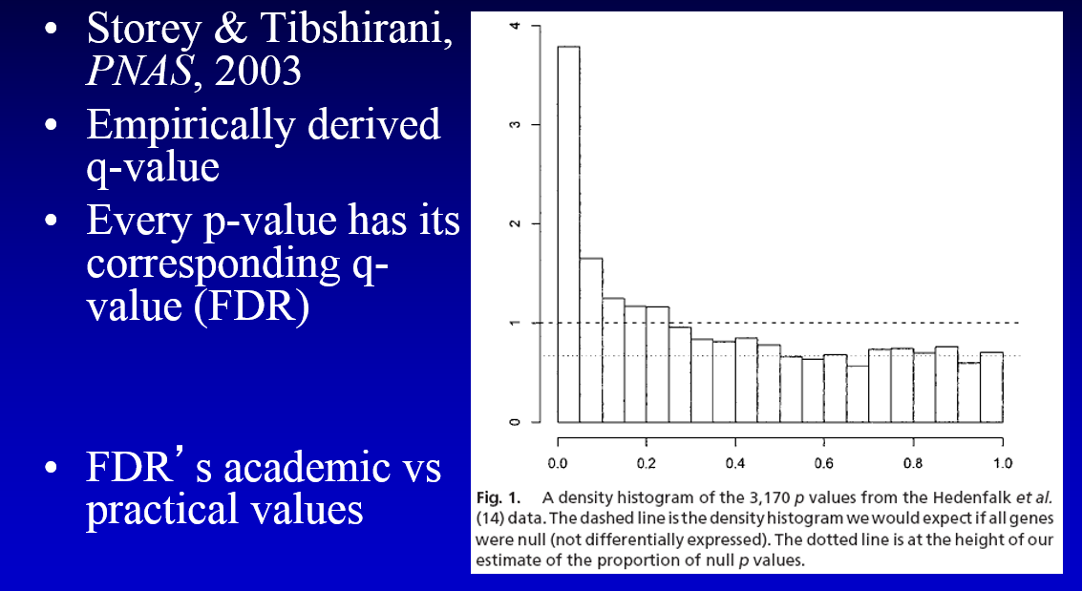
*q-value

Slide 53
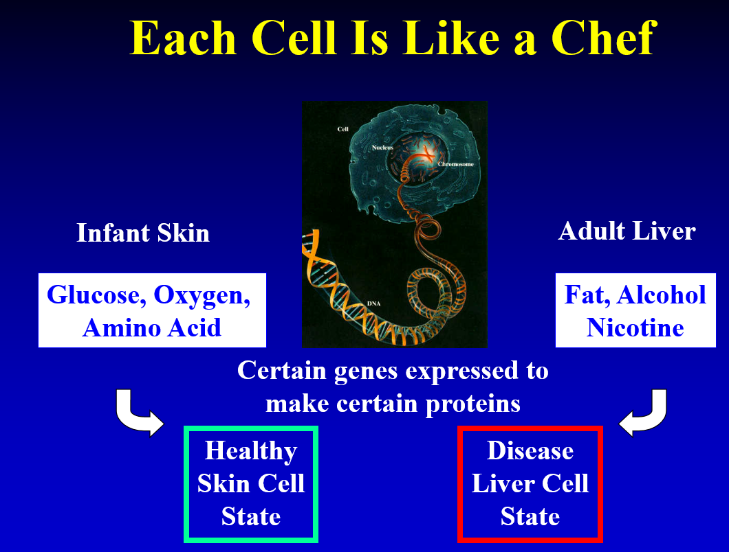
Motif finding

Slide 54
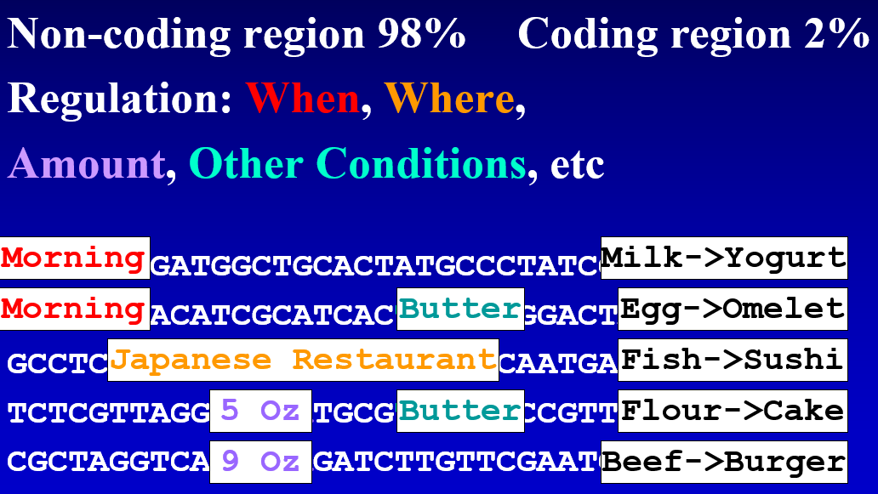

Slide 55
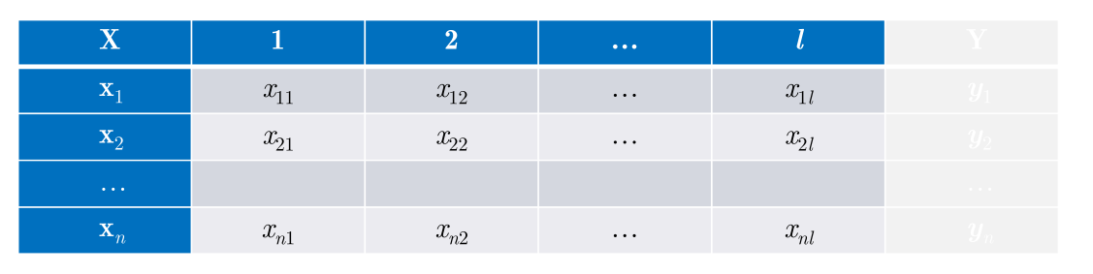
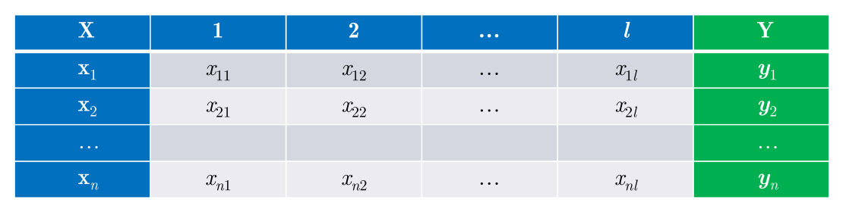
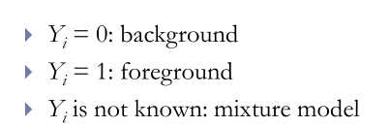

Slide 56
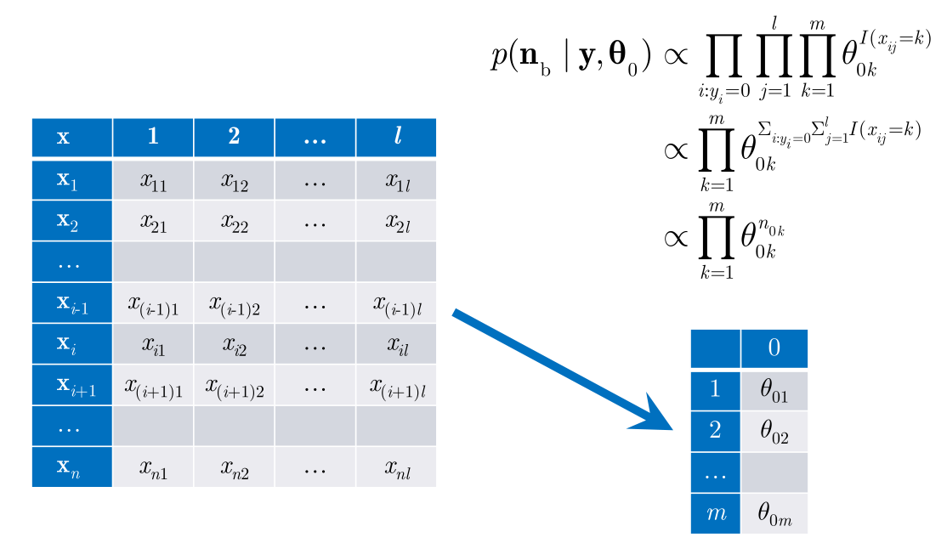
Background

Slide 57
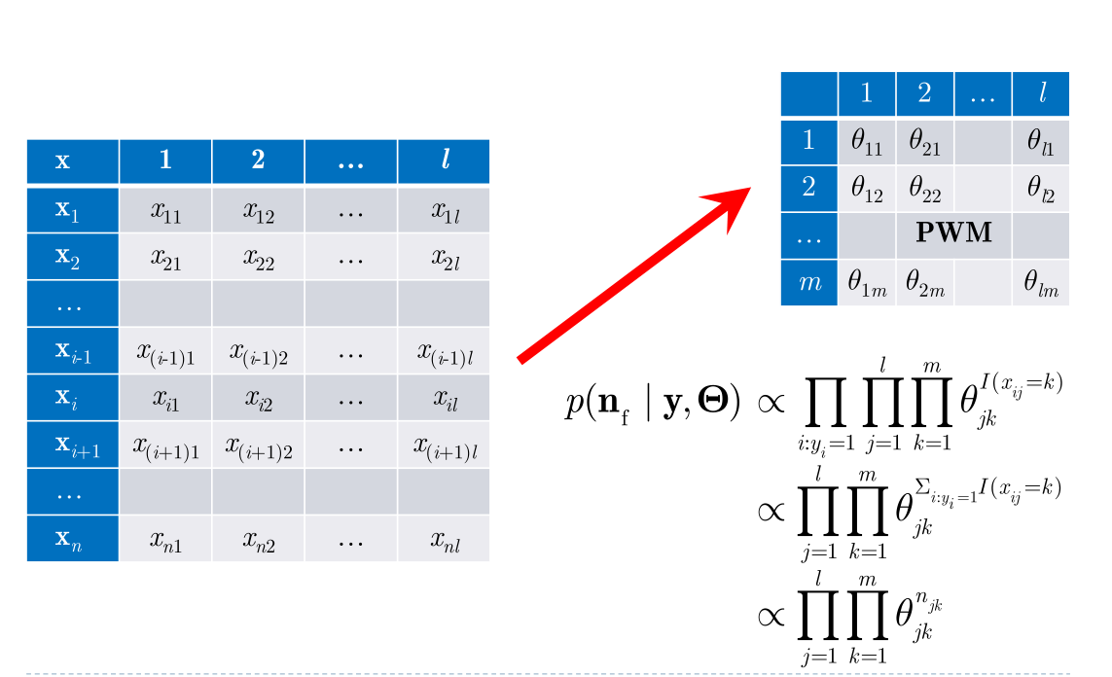
Foreground

Slide 58
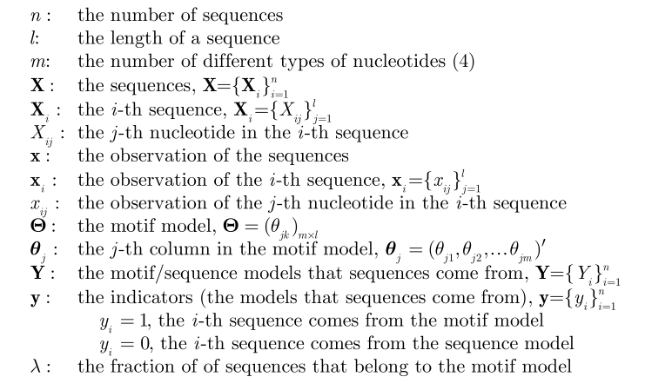
Mixture Model

Slide 59
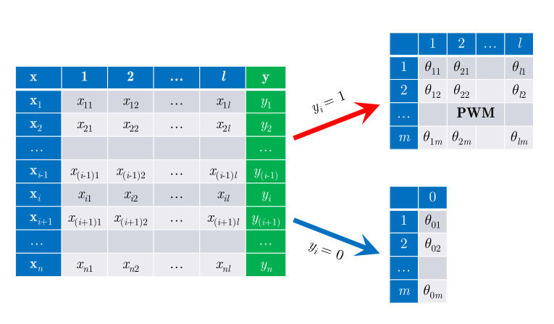

Slide 60
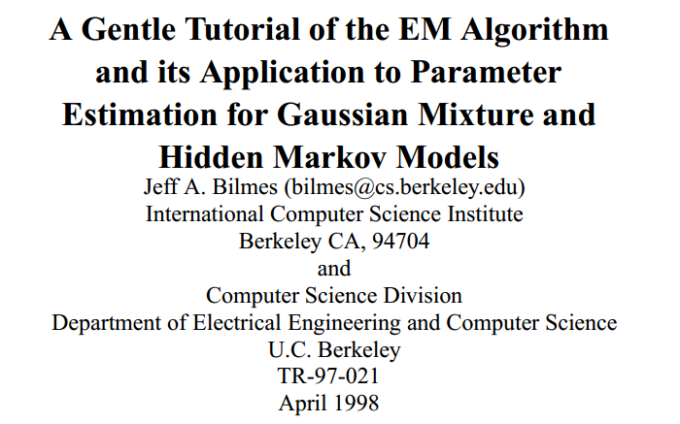
EM algorithm
Suppose we have a guess about the parameters l, θ 0 , and Θ, we can update the probability (expectation) that each y is equal to 1.
Suppose we known the probability (expectation) that each y is 1, we can estimate l, θ 0 , and Θ with MLE.
If we can do both of the above inferences, we can
Guess l , θ 0 , and Θ
Calculate the expectation of y
Update l , θ 0 , and Θ using x and y
Iterate over the above two steps until convergence

Slide 61
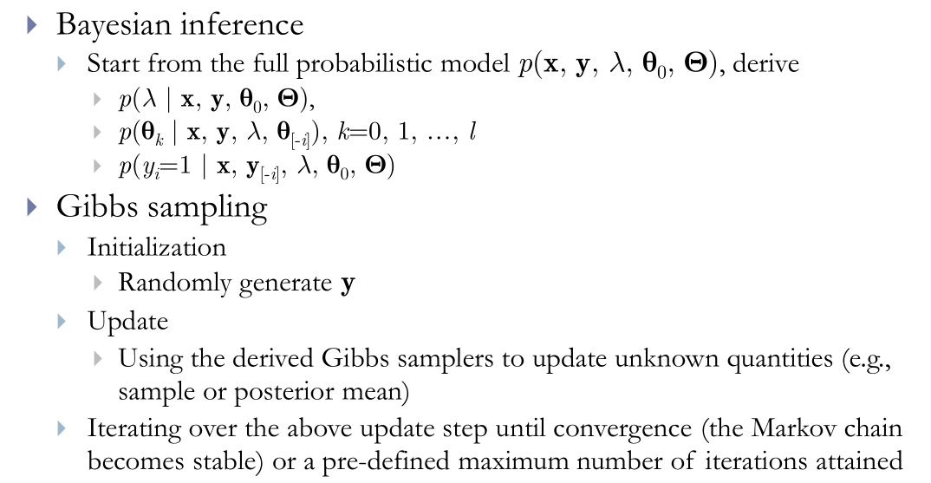
Gibbs sampling
If we are Bayesian, then how we handle it ?

Slide 62
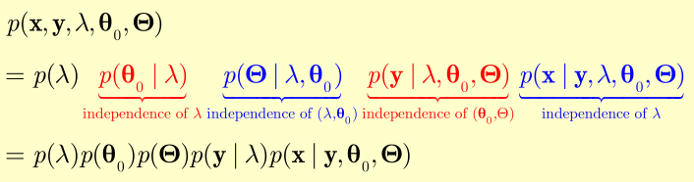
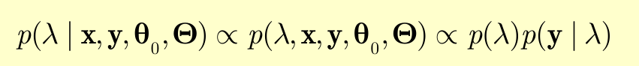
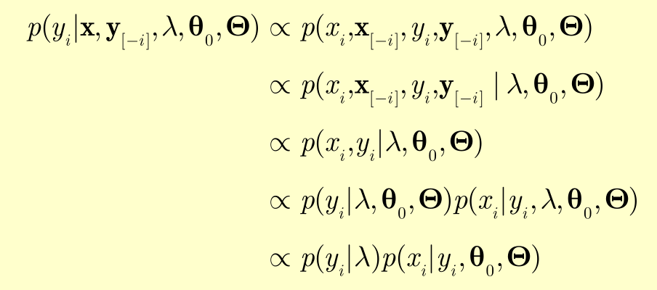


Slide 63

Regular Expression
Powerful in text mining.
Easy and interesting.
R, python, shell (including grep, awk,
sed), vim… All of them support RE.

Slide 64
Homework 1
Implement the Swiss-Waterman algorithm by R.
Blast: (See the word document).
Read blast from WiKi.
*E-value:
Read the paper “relating protein pharmacology by ligand chemistry”(Nature Biotechnology 2007) and its supplementary information.
Can you understand how the author applied the idea of E-value in the method?

Slide 65
REFERENCE
The Book “Bioinformatics –Sequence and Genome Analysis ” by David W.Mount
Extreme Value Distribution (http://mathworld.wolfram.com/ExtremeValueDistribution.html)
PPT of Sequence Alignment from Lakshmanan Iyer, Ph. D.
PPT of Dynamic_Programming.ppt on line.
PPT of BLAST Similarity Searching Clark University, Spring 2008
Dynamic Programming: WiKi.
PPT of Statistical Inference from Rui Jiang
The Book “Statistical Inference” by George Casella and Roger L.Berger.
PPT from Xiaole Shirley Liu, STAT115/STAT215, Harvard.

